Slide 1
documentary
History and modes

Slide 2
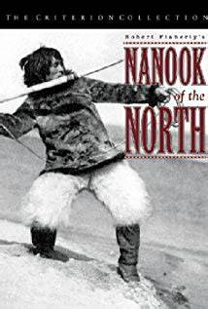
Early documentary
Lumiere Brothers and their “Actualities,” like Exiting the Factory
1920s:
Nanoook of the North (1922): included typical film elements like close ups, parallel editing
Also worked with re-enactments
Newsreels
Propaganda (esp. in USSR-films shown on trains to highlight benefits of the Bolshevik Revolution)

Slide 3
1930s and 1940s
Filmmaker John Grierson said that film should be a “hammer, not a mirror”
Many focused on social issues and subjective films
Used for war effort
Germany: Triumph of the Will (at Nuremberg rally)
US: Frank Capra’s “Why We Fight” series (WWII)

Slide 4
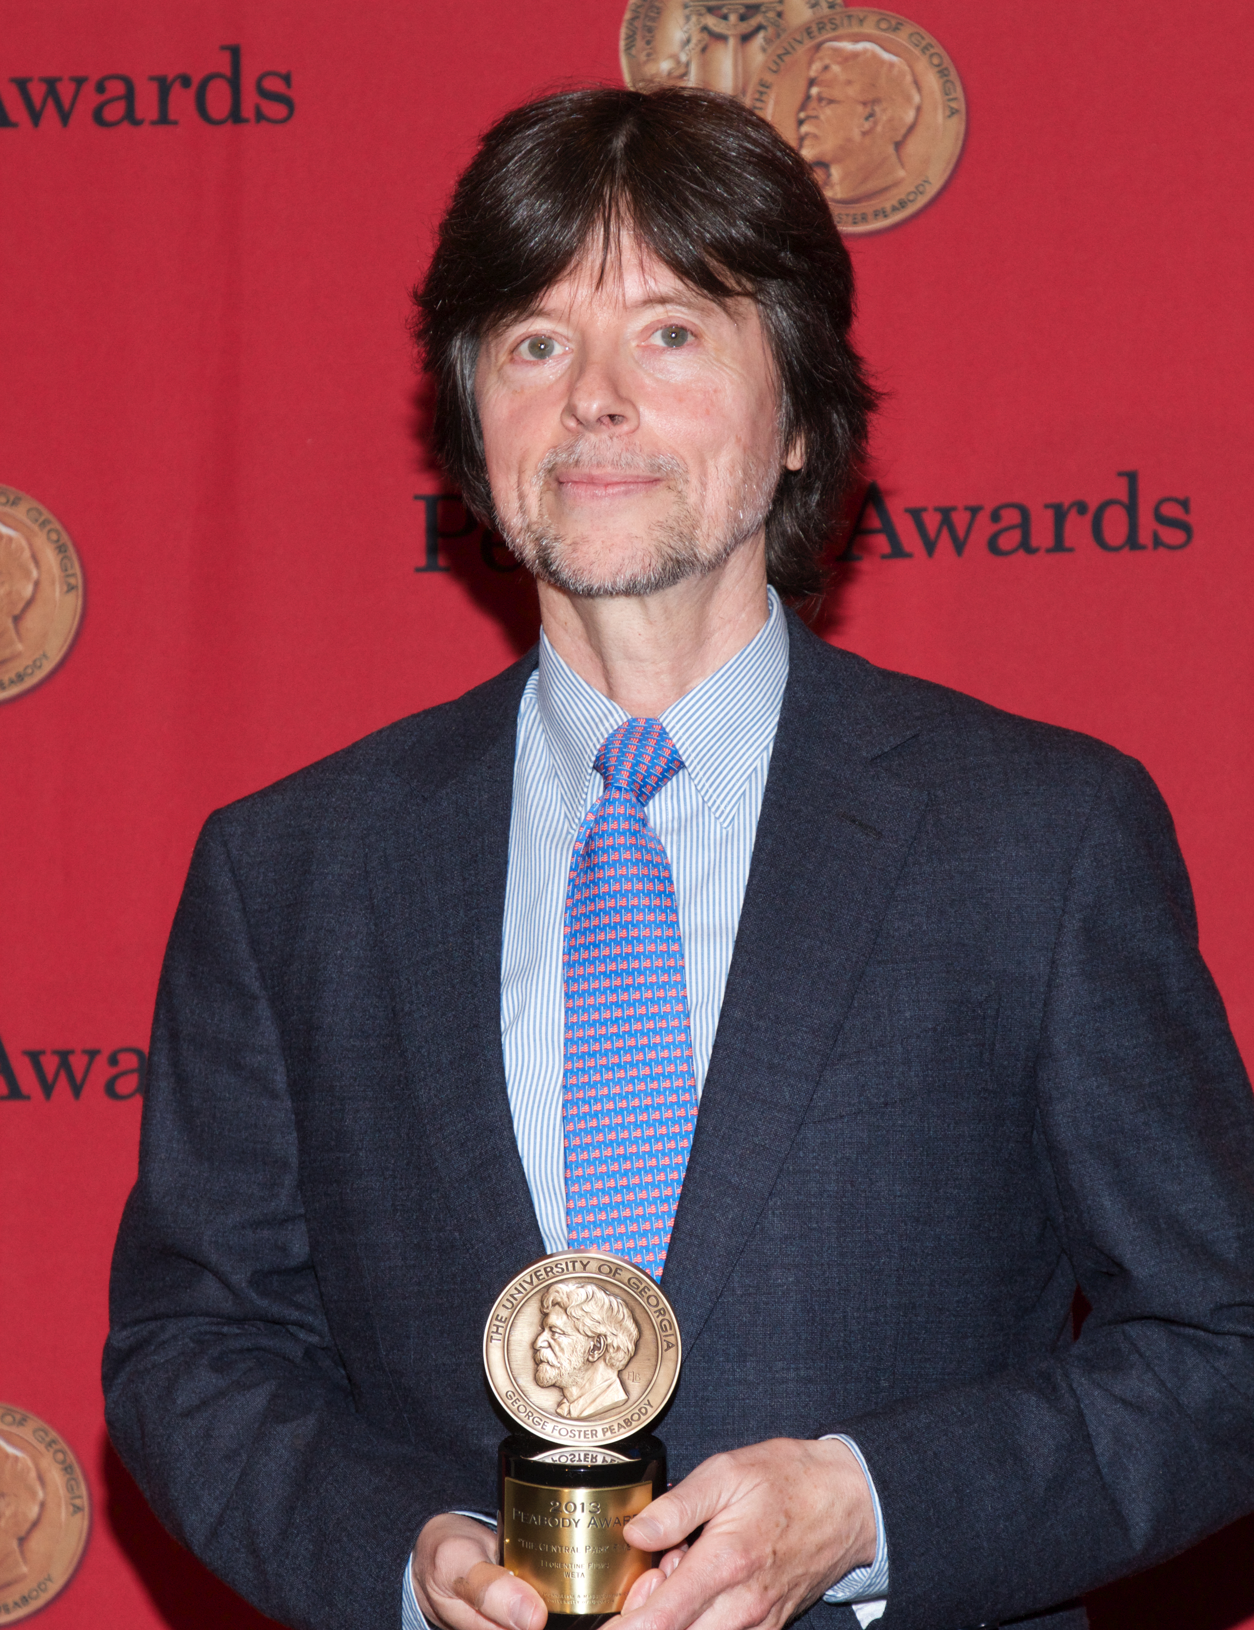
195os to PRESENT
Planet Earth
50s to 70s:
“fly on the wall” approach
“cinema verite” or “cinema truth” came into being in which filmmaker or cameraman sometimes was a participant in the film
80s to present
First person documentaries
Film essays that told very personal stories
Cable: Ken Burns for PBS, Planet Earth for BBC
Online: YouTube, Tik Tok→do they count???

Slide 5
modes
Expository
Personal Voice
Observational/Direct Cinema/Cinema Verite
Hybrid/Synthetic

Slide 6
expository
Traditional
Objective, expresses facts
Often includes narrator (aka-Voice of God)
EX: March of the Penguins (Morgan Freeman)
EX: Planet Earth (Sigourney Weaver)

Slide 7
Personal Voice
1st person narrator, who either is director explaining the film or the person being filmed
Involves more opinion
Notable for intimacy/honesty
EX: Supersize Me (Morgan Spurlock), Sicko (Michael Moore)
EX: Autism is a World (Sue Rueben)

Slide 8
Observational/direct cinema/ cinema Verite
“fly on the wall” approach to capture action as it happens, with minimal crew interference
Sometimes subjects being filmed are aware of camera’s presence and speak directly to it (sometimes in interview form)
EX: John and Kate Plus Eight, Big Brother, Lady Gaga-Five Foot Two

Slide 9
Hybrid/synthetic
Mix of modes
Characterizes many of today’s documentaries

